Slide 1
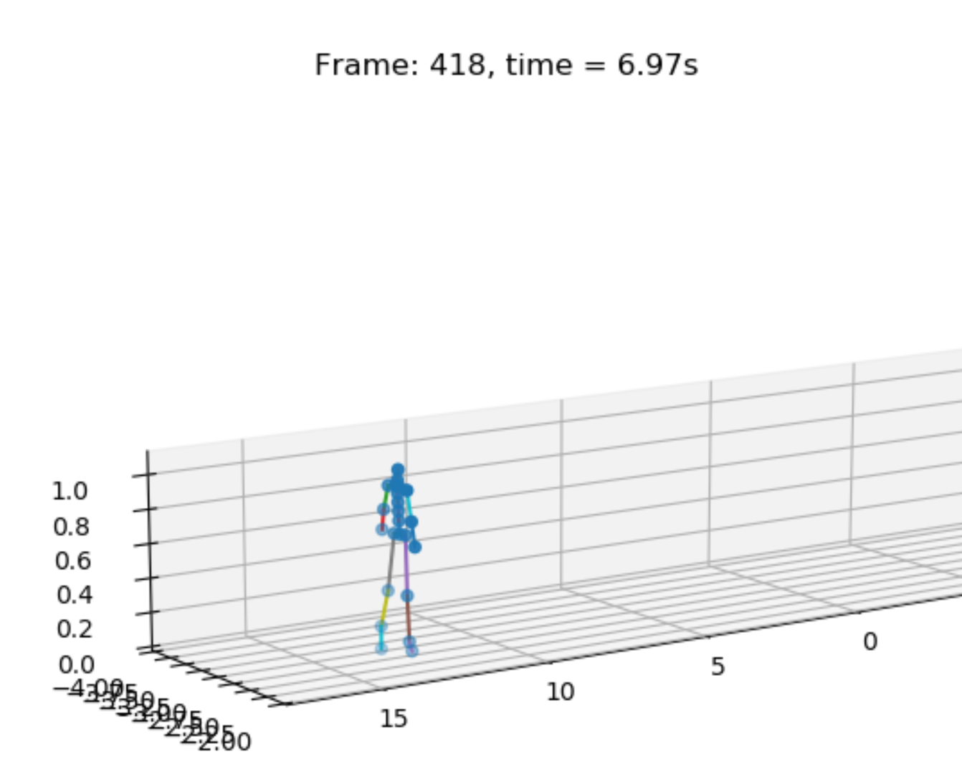

‘file_mover.py’
‘assess_nsaa_nmb_file.py’
(Connected to most scripts to fully assess a single file)
Google sheet activity annotations
Suit data (one .mat file per subject visit)
‘dis_3d_pos.py’
‘settings.py’
(Connected to every other script)
3D visualization of suit data over time
‘mat_act_div.py’
‘comp_stat_vals.py’
‘file_renamer.py’
(Not connected to any other scripts, just renames .mat files)
Legend
Suit data as .mat files (each file is 1 act of 1 subject)
Unseen suit data .mat file (e.g. from NSAA tests, 6MW, or unstructured movement)
Extracted statistical features
Directory of files the model was not trained on
= data source
= Python script
= output to console
= output to file
= data in intermediate state
‘ext_raw_measures.py’
‘ft_sel_red.py’
‘model_predictor.py’
‘test_altdirs.py’
Raw measurement data from .mat files
Reduced-dim statistical features
‘model_predictions.csv’
‘predictions_selector.py’
(no outline)
‘data_balancer.py’
‘rnn.py’
‘RNN Results.xlsx’
‘graph_creator.py’
Single act score of 0, 1, or 2 of a single sequence (only for single-act files)
Overall NSAA regression score (between 0 and 34) of a single sequence
Classification of being from either ‘D’ or ‘HC’ file of a single sequence
Classification of NSAA single activity scores for all 17 actions of a single sequence

